Slide 1
Networking and the internet
Lesson 6: A community guide to the internet

Slide 2
Objectives
In this lesson, you will:
demonstrate what you have learnt about networking and the internet over the course of the module
identify strengths and areas for improvement in your understanding.

Slide 3
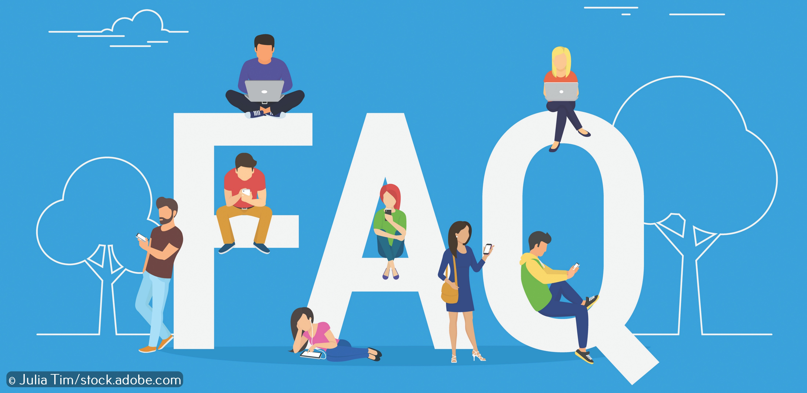
Frequently Asked Questions (FAQs)
Imagine your school is launching a project to help students, their parents and members of the wider community become more confident using online technology.
The school has asked people what they struggle with and what they want to know more about and has collected together a list of Frequently Asked Questions (FAQs).

Slide 4

Activity 6.1: A community guide to the internet

Slide 5
Activity 6.2: Play Toppers!
In pairs collect your Topper cards together and shuffle them.
Deal the cards evenly to everyone who is playing face down.
The player to the left of the dealer begins by reading out a category from their top card (for example, ‘Cost 12’). The other players then read out the same category from their top card. The person with the highest value wins, collects the other players’ cards and places them at the bottom of their pile. It is now their turn to read out a category.
If two or more cards are the same, the cards are placed in the middle and the player reads out a category from their next card. The winner collects the cards in the middle along with the cards won during their winning turn.
The person with the most cards at the end is the winner.

